Slide 1


Slide 2
Quantum Machine Learning
The Future of Artificial Intelligence

Slide 3
Timeline
1920- Now - Era of Classical Computing
2010s – Started Using Artificial Intelligence
2015 – Because of the growth of data, the Machine Learning era started
2020 - We found some drawbacks in classical computing and classical processors, which made people curious about Quantum computing
By 2030, - We are expecting to blend Machine Learning with Quantum to see the rapid progress in the computational power

Slide 4
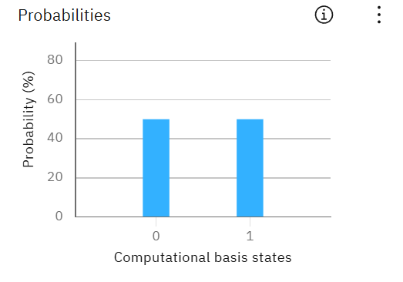
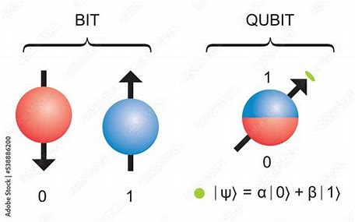
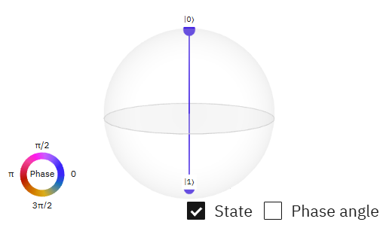
Quantum Computing?
Superposition of two states |0> and |1>
Classical
Quantum

Slide 5
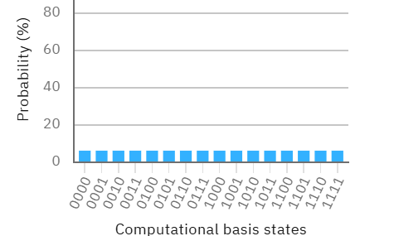
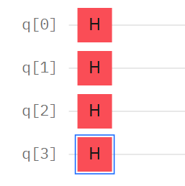
Here, 16 states are generated by 4 qubits by performing one operation, Whereas Classical computers need 16 operations, which is more time-consuming
Which made it possible to utilize properties like entanglement, superposition, and Interference

Slide 6

Why ML with Quantum
(ML) : Like a chef who learns to cook by trying thousands of recipes (data) to find the best one.
Quantum Computing : Like a magical kitchen where you can test all recipe combinations at once.
QML: "Now, the chef has the magical kitchen—instantly knowing which recipe works best without wasting time!"
utilizing quantum computing principles to enhance the effectiveness of traditional ML models.

Slide 7
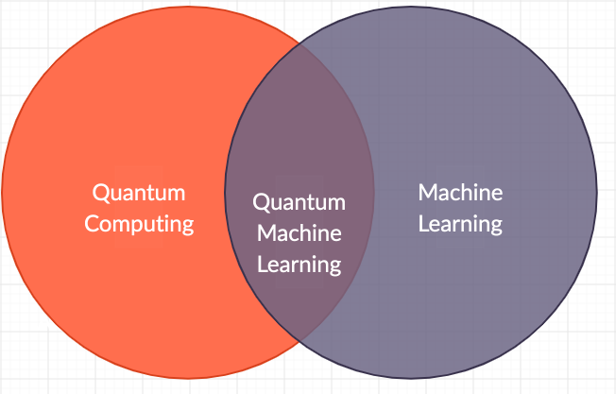
Motivation Behind Quantum Machine Learning (QML)
Limits of Classical Machine Learning
"Big Data is Getting Too Big": ML models today require massive amounts of data, which involves a lot of computational time and processing power
“Some Problems Are Too Complex”: tasks like simulating molecules for drug discovery are impossible for classical computers to solve.

Slide 8
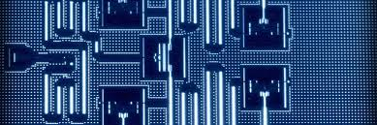
QML over classical ML
Quantum computers don’t just compute faster—they compute differently
Exponential Speedup
Classical computers check possibilities one at a time - Quantum computers explore all possibilities at once helps in speeding up things like drug discovery
Better Optimization
Quantum algorithms can navigate this space more efficiently by processing all solutions at a time and giving the best one, like finding the fastest path for every car in a city in real time.
Handling "Quantum Data"
Some real-world data (like chemical reactions or particle physics) behaves quantum-mechanically.

Slide 9
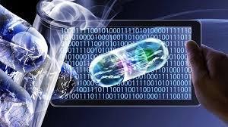
The Bigger Vision: What Could QML Enable?
Scientists and companies are exploring QML for:
Medicine: Personalized cancer treatments by simulating DNA-protein interactions.
Climate Science: Discovering new materials for carbon capture.
Finance: Ultra-secure encryption and fraud detection.
AI: More powerful models that learn from less data.

Slide 10
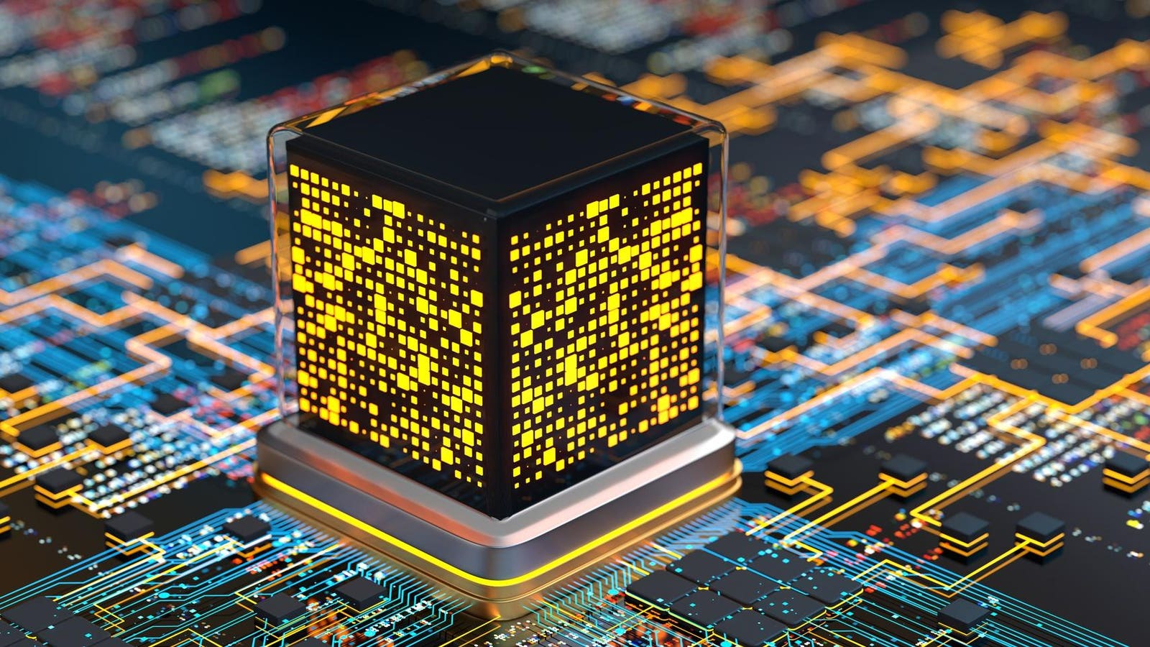
Current Challenges in QML
Hardware limitations
Noise and decoherence
Circuit depth and scalability
Data loading (quantum feature maps are expensive)
“Research shows there is huge progress to overcome these in the coming years”

Slide 11
The Future of Quantum Machine Learning
Scalability: The Million-Qubit Dream 🚀
Research Outlook🎯
Hybrid Approaches: Quantum + Classical Teamwork
Near-Term Applications (NISQ Era): The Million-Qubit Dream
"From lab curiosities to industrial tools"
"The next 5 years will redefine what’s possible"
“Drug discovery, financial modeling”
"Using quantum where it shines, classical where it’s stable"

Slide 12

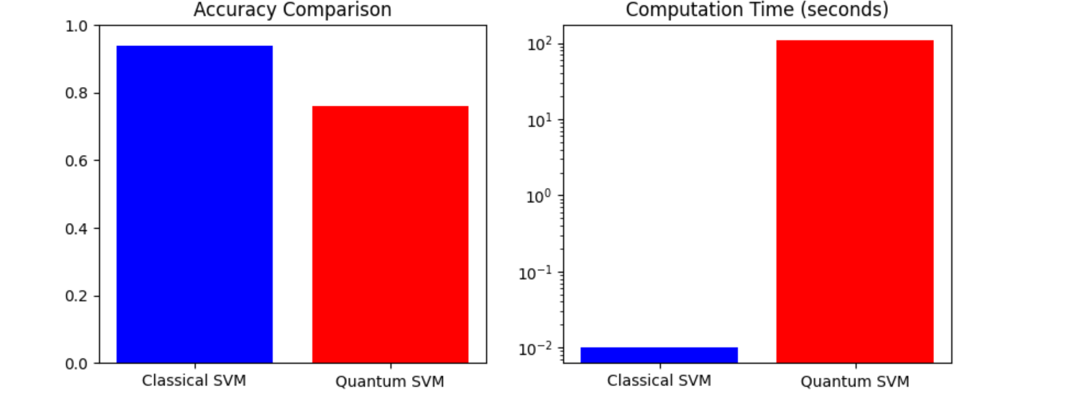
QML for Cancer Detection
I tried to develop QML and Classical ML algorithms to detect breast cancer by evaluating the patient data, which has great significance in
Health care domain.
😕

Slide 13
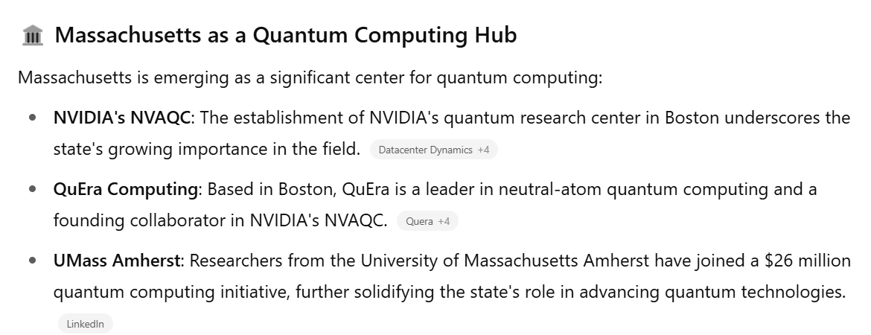
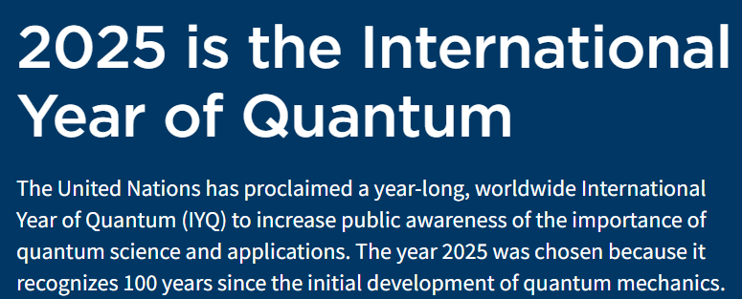
Interesting facts about Quantum

Slide 14
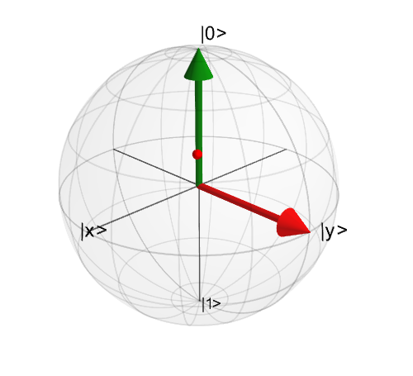
Thank You
“Think of quantum ML like early spaceflight—we’re still building the equivalent of propeller planes, but one day we’ll have quantum ‘jet engines’. The next decade will decide whether this becomes mainstream tech or remains a specialized tool."

Slide 15
References
Section | Reference
Research | Wikipedia & Medium articles: Quantum Machine Learning overview
Coding Tutorial | Google's Cirq library: quantum circuit simulation
Future Scope | GeeksforGeeks article on future of Quantum Machine Learning (QML)

